Slide 1
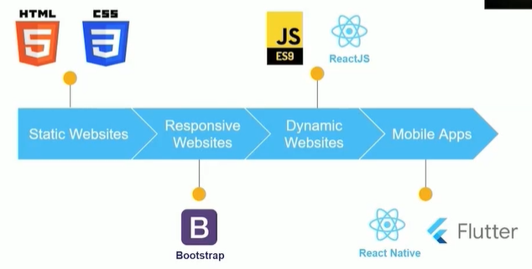
STATIC WEBSITE

Slide 2
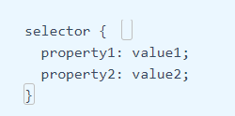
CSS
Rule set syntax:
Give selector name to the container

Slide 3
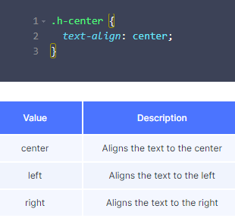
CSS
Text align property

Slide 4
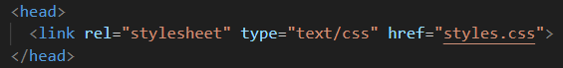
CSS = styles.css for ever file

Slide 5

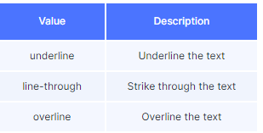
CSS TEXT PROPERTIES
Color
Font family
Font size = in pixels
Font style = italic
Font weight = bold/ 200
Text decoration = underline, overline, line through
Text align

Slide 6
CSS BACKGROUND PROPERTIES
background color
Background size
Background image = url
background-repeat: no-repeat; (image will not be repeared )
background-size: 100% 100%; ( Adjust the background size to cover the entire element )

Slide 7
CSS BOX PROPERTIES
Height = % px vh
Width = % px vw
width: 100%; (Ensure the card takes up the full width of its container )
Margin = spacig b/w 2 elements ,px, main container lo ivvali
Border
Padding

Slide 8
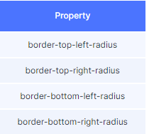
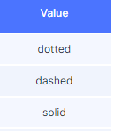
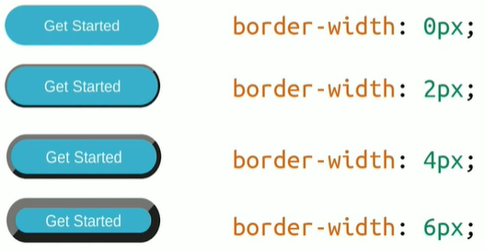
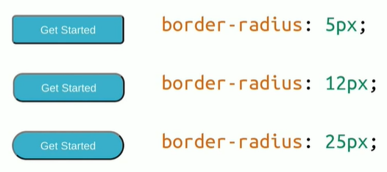
CSS BUTTON PROPERTIES
Border width = px
Border radius = px
Border color = hexcodes
Border style
Padding = px

Slide 9
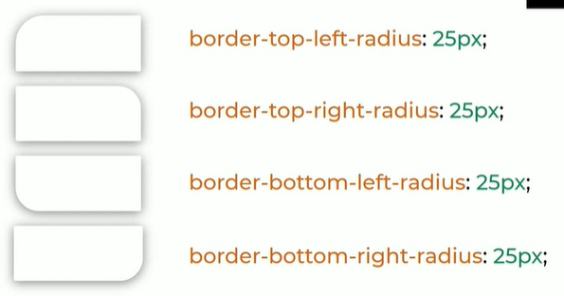
Container properties-BORDER RADIUS TO CORNER

Slide 10
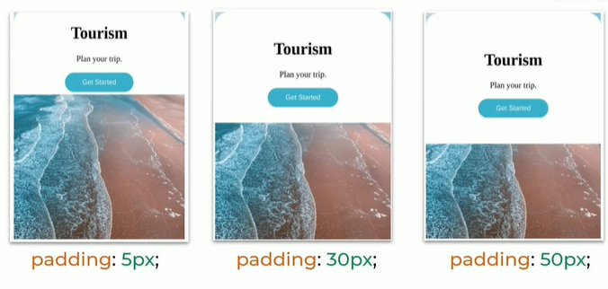
GET SPACING INSIDE THE CARD

Slide 11
BOOTSTRAP- add in head section
<link rel="stylesheet" href="https://stackpath.bootstrapcdn.com/bootstrap/4.5.2/css/bootstrap.min.css" integrity="sha384-JcKb8q3iqJ61gNV9KGb8thSsNjpSL0n8PARn9HuZOnIxN0hoP+VmmDGMN5t9UJ0Z" crossorigin="anonymous"/><script src="https://code.jquery.com/jquery-3.5.1.slim.min.js" integrity="sha384-DfXdz2htPH0lsSSs5nCTpuj/zy4C+OGpamoFVy38MVBnE+IbbVYUew+OrCXaRkfj" crossorigin="anonymous"></script><script src="https://cdn.jsdelivr.net/npm/popper.js@1.16.1/dist/umd/popper.min.js" integrity="sha384-9/reFTGAW83EW2RDu2S0VKaIzap3H66lZH81PoYlFhbGU+6BZp6G7niu735Sk7lN" crossorigin="anonymous"></script><script src="https://stackpath.bootstrapcdn.com/bootstrap/4.5.2/js/bootstrap.min.js" integrity="sha384-B4gt1jrGC7Jh4AgTPSdUtOBvfO8shuf57BaghqFfPlYxofvL8/KUEfYiJOMMV+rV" crossorigin="anonymous"></script>

Slide 12
Import this in CSS
@import url("https://fonts.googleapis.com/css2?family=Bree+Serif&family=Caveat:wght@400;700&family=Lobster&family=Monoton&family=Open+Sans:ital,wght@0,400;0,700;1,400;1,700&family=Playfair+Display+SC:ital,wght@0,400;0,700;1,700&family=Playfair+Display:ital,wght@0,400;0,700;1,700&family=Roboto:ital,wght@0,400;0,700;1,400;1,700&family=Source+Sans+Pro:ital,wght@0,400;0,700;1,700&family=Work+Sans:ital,wght@0,400;0,700;1,700&display=swap");

Slide 13
Bootstrap link
https://getbootstrap.com/docs/4.6/components/alerts/

Slide 14
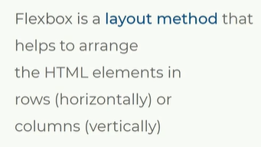
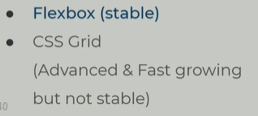
METHODS TO DESIGN LAYOUT
To design layout we have 2 methods namely:
Flexbox
CSS grid

Slide 15
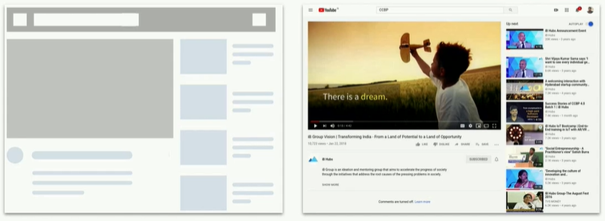
Eg of layout = utube layout

Slide 16
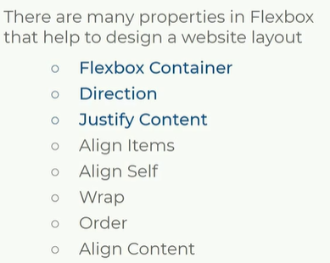
FLEXBOX PROPERTIES
Bootstrap lo flex box anedi use cheyali

Slide 17
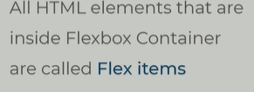
FLEX CONTAINER
Ey container ni flex container cheyalo Decide avvu
Flex container ni define chesaka ah container lo unna html tags ni flex items antam

Slide 18
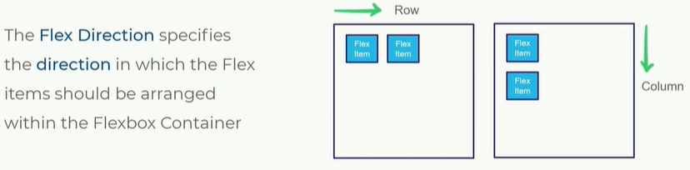
FLEX DIRECTION

Slide 19
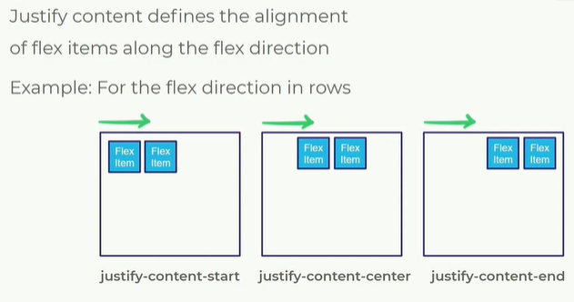
JUSTIFY CONTENT

Slide 20
Define the background container as flex container = d-flex
Ey container kindhaki digalo ah main container ni d-flex ,flex-column, justify-content-end
specify direction with flex row or flex column
Content start lo undala , center , end lo undala define with justify-content-end

Slide 21
Using bootstrap for flex
d-flex
Specify direction - flex column or flex row
justify-content-end / center/ start

Slide 22
flex box class names
display: flex; | Made flex container
flex-direction: column; | Specified direction of flex
justify-content: flex-end; | Specify content of flex

Slide 23
Card container Text container
How to keep images in html elements
Src attribuets void elements
Box properties
Margin

Slide 24
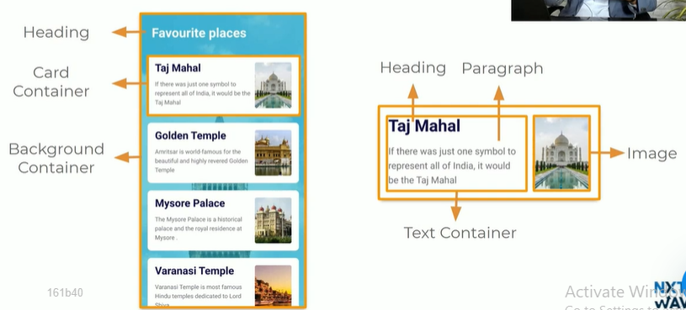
DEVELOPING LAYOUTS

Slide 25
Diff b/w padding & margin
Margin = elements middle lo space
Padding = 4 borders ki space

Slide 26
On click attribute for navigation in bootstrap
Onclick double quotes
In middle of double quotes pass values
onclick="display('section1')">

Slide 27
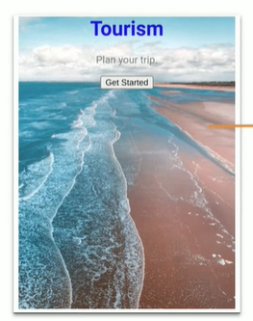
ACHIVE

Slide 28
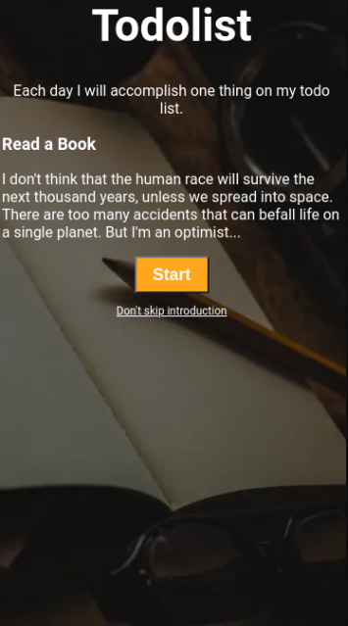

Slide 29
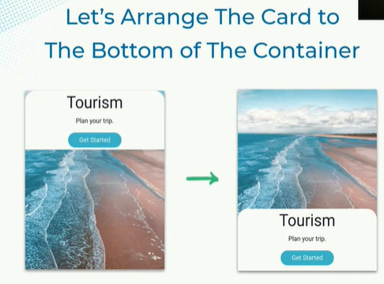
ACHIEVE THIS WITH FLEX PROPERTIES

Slide 30
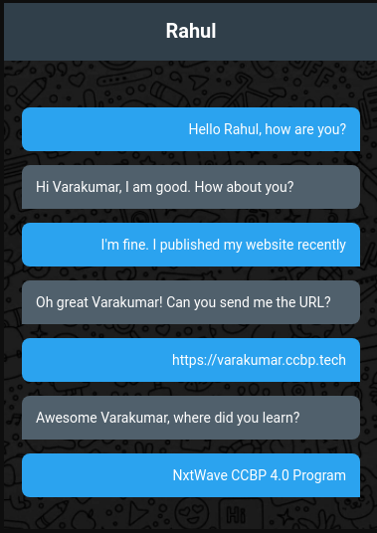

Slide 31


Slide 32
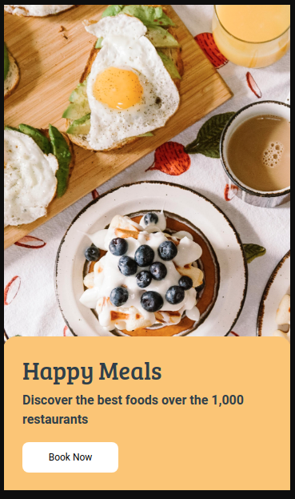

Slide 33
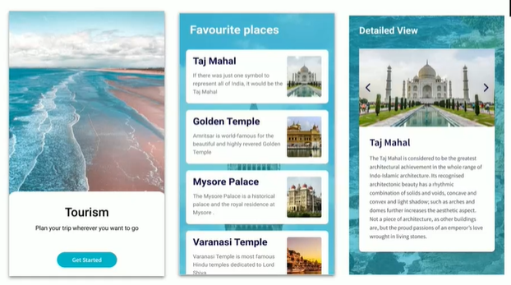

Slide 34
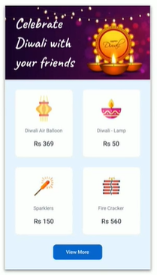

Slide 35


Slide 36


Slide 37


Slide 38
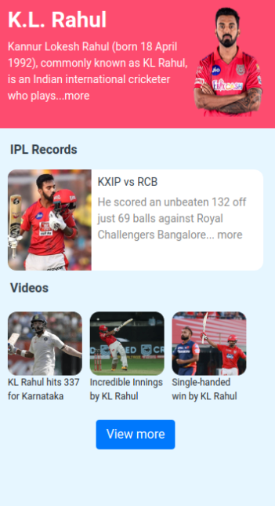

Slide 39
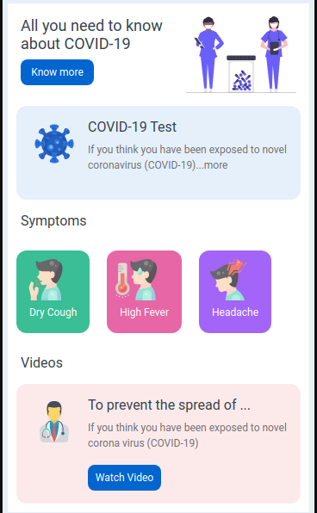

Slide 40
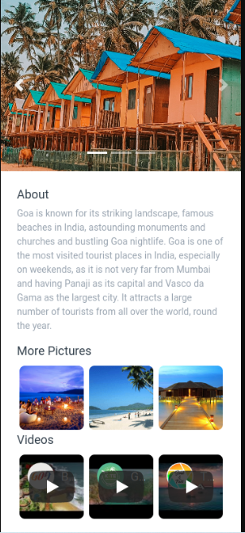

Slide 41
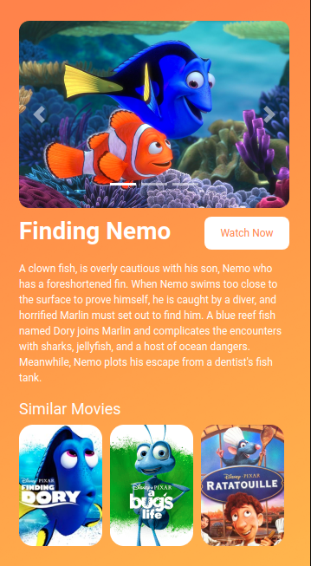

Slide 42
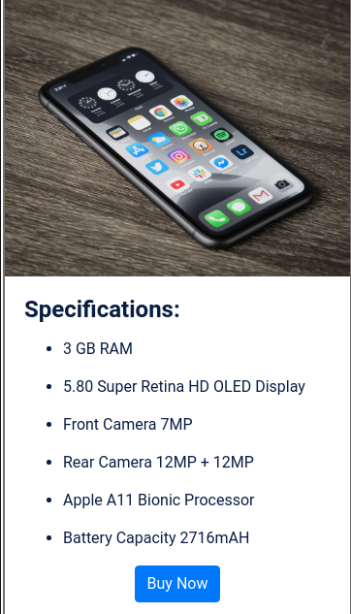

Slide 43


Slide 44
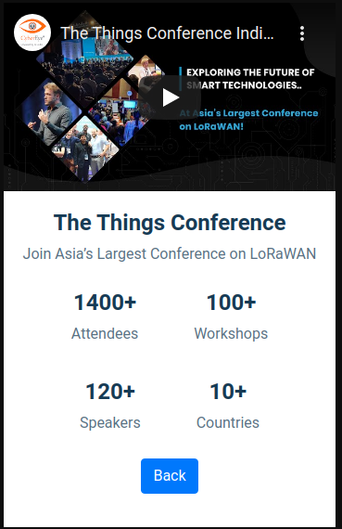

Slide 45
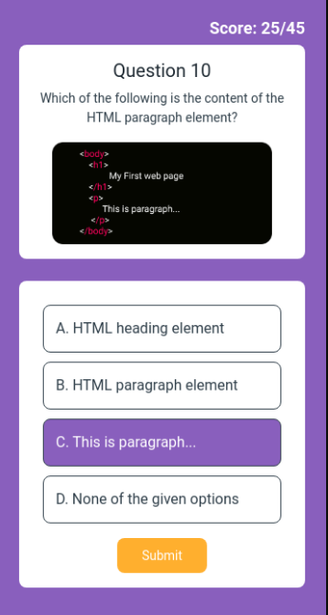

Slide 46
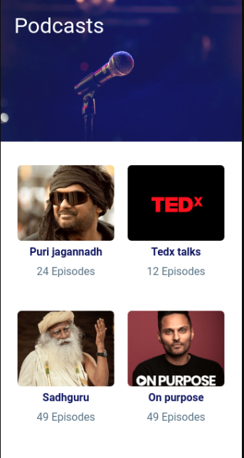

Slide 47
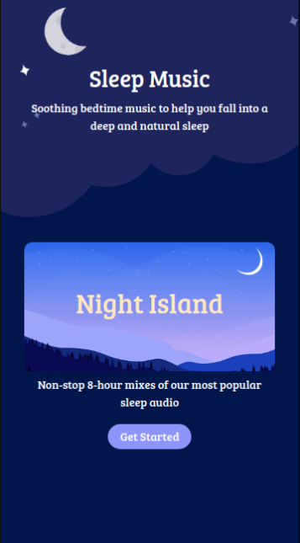

Slide 48
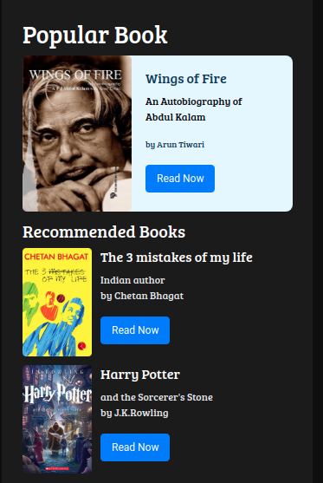

Slide 49
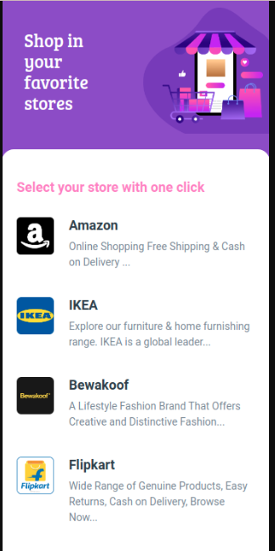

Slide 50

☑

Slide 51
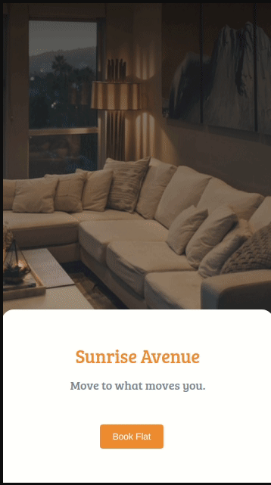
☑

Slide 52

☑

Slide 53
